Slide 1
Python for Data processing
Lecture 3:
Arrays, tensors and computations - Part III
Kosta Rozen

Slide 2
What we already know
A lot about NumPy arrays:
creation
indexing
universal functions
linear algebra
best practices
I/O

Slide 3
This lecture
PyTorch:
basics
operations
gradients
logistic regression

Slide 4
Why NumPy is not enough
NumPy arrays are great but:
they work only on CPU
they provide only basic building blocks
For deep learning:
CPU/GPU/TPU/?
gradients

Slide 5
PyTorch
tensors provide the same operations as NumPy arrays
work on CPU/GPU/TPU
provide autogradients
deep learning building blocks
efficient data loading
deployment

Slide 6
PyTorch tensors

Slide 7
→let’s try it out!
Tensors
similar to arrays, provide the same computational facilities
can share data
can live on different devices
provide declarative computations

Slide 8
tensor
tensor
tensor
storage
storage
shape, strides,
offset
dtype, size
Tensors and storage

Slide 9
tensor
tensor
Device dispatch
dtype dispatch
CPU
GPU
kernel
→let’s try it out!
Devices and computations

Slide 10
→let’s try it out!
View, copies, reshaping
PyTorch is a bit more elaborated:
view: always returns a view or fails
reshape: returns either view or new tensor
depends on contiguity constraints

Slide 11
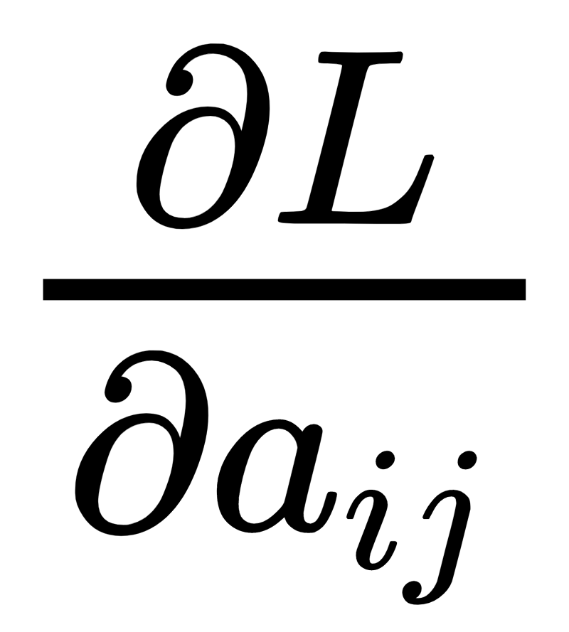
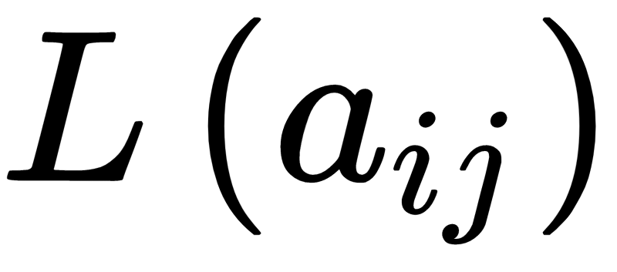
→let’s try it out!
Gradients
In deep learning we need gradients:
to calculate updates to network parameters (weights)
no way to do that in NumPy
an easy go in PyTorch (a bit more elaborated in Tensorflow)
(scalar) → (tensor)

Slide 12
Logistic regression with PyTorch

Slide 13
Logistic regression: setup
two-dimensional input (created with make_blobs from sklearn.datasets)
binary classification with linear decision boundary
output: sigmoid
from scratch

Slide 14
LR breakdown
b
Wx
Wx+b
W
x
x
b
Scalar product of W and x: Wx = W₀x₀+W₁x₁
Add bias b: W₀x₀+W₁x₁ + b
P(red) < 0.5
P(red) > 0.5
P( ) = σ(Wx+b)
b
Apply Sigmoid function:
If Wx+b > 0, then P( ) > 0.5
If Wx+b < 0, then P( ) < 0.5
P( ) = P( ) - decision boundary

Slide 15
class labels
0
1
0
1
0
1
0
1
sigmoid output
good
bad
Log loss
We want: probability ↓ for class 0, probability ↑ for class 1

Slide 16
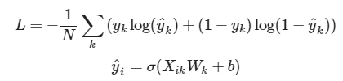
Log loss function
Log loss is -1 * the log-likelihood function you learned in probability course as part of max-likelihood method for parameter estimation:
True value of sample k: 1 for red or 0 for blue
Predicted probability of sample k being red
Predicted probability of sample k being blue
Number of samples
1 if sample
k is blue

Slide 17
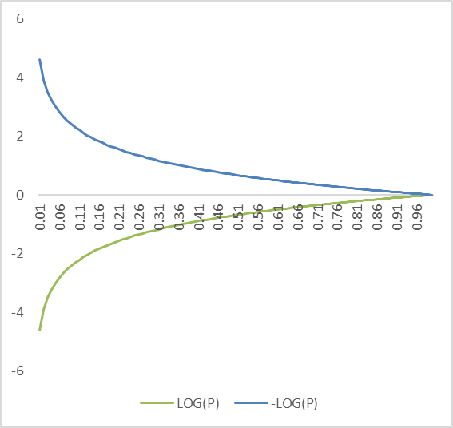
→let’s try it out!
Log loss function
Log parts of the function represent the cost of error when estimating probability:
When we’re right (p=1), log(p) is 0
When we’re wrong (small p), log(p) is negative and -log(p) is positive.
The smaller p is, the larger the error (-log) will be.

Slide 18
What we’ve learned
PyTorch tensors and gradients
how to perform simple gradient descent

Slide 19
Assignment
explore PyTorch tensor operations

Slide 20
questions?

